Slide 1
MARKETING ANALYTICS ASSIGNMENT- 1 (Group 21)
Nan CHEN
Oskar GIRARDIN
Victor MAILLOT
Arindam ROY
Yangfan ZHANGLIN

Slide 2
DB Description
In the following section, we discuss the key relevant data to it in our database

Slide 3
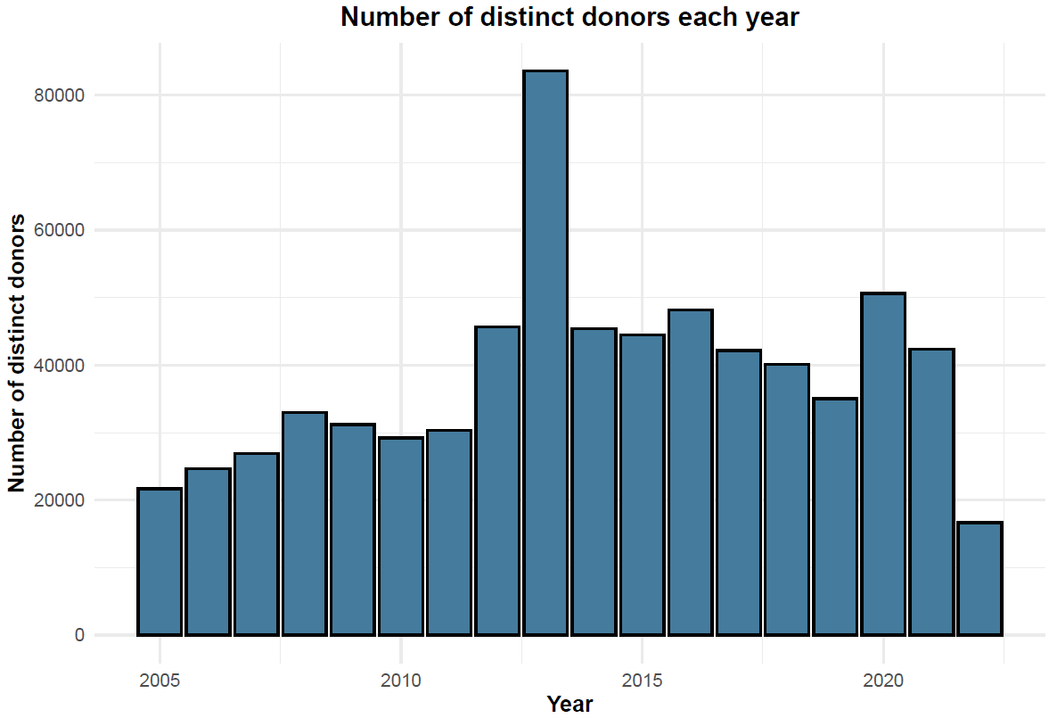
Distinct Donor Count
The number of donors appears to be on an uptrend
2013 is an anomaly year, with significantly high number of donors

Slide 4
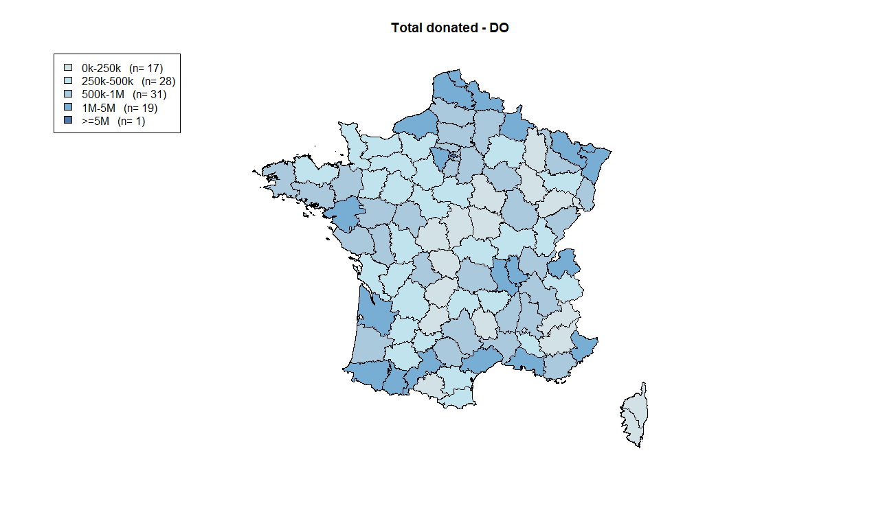
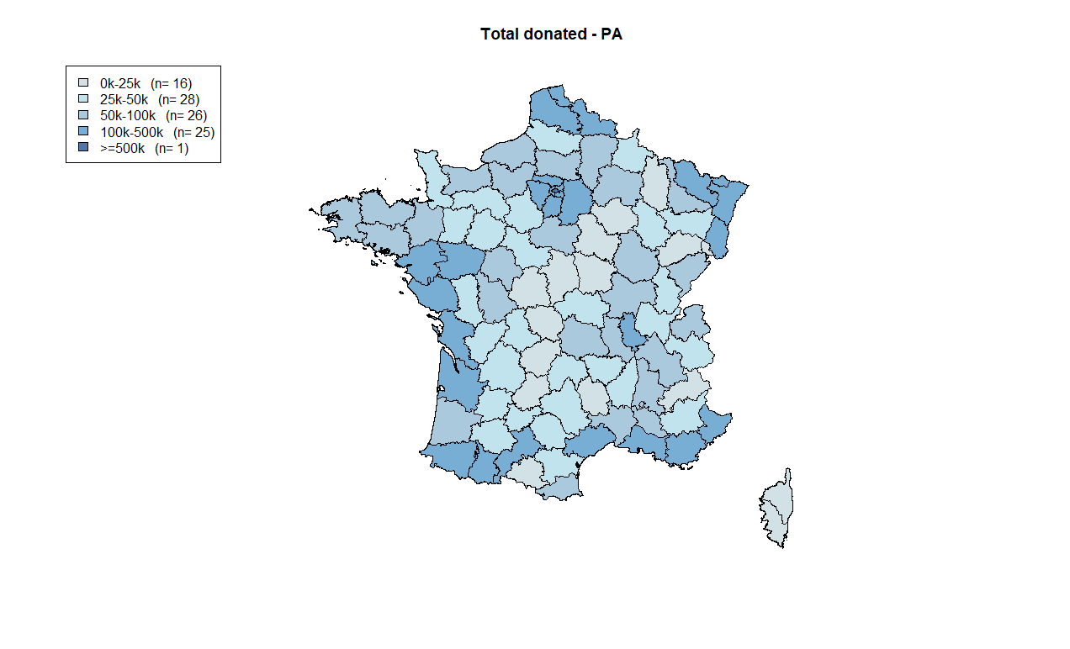
Distinct Donor Geography

Slide 5
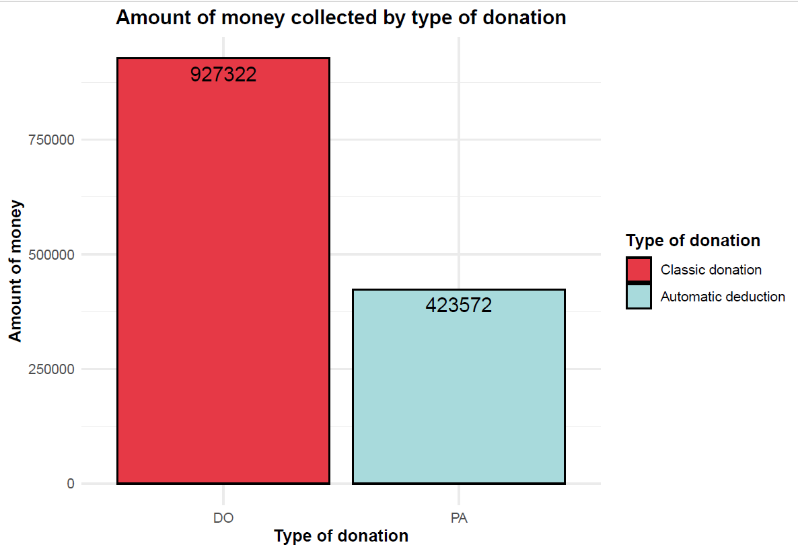
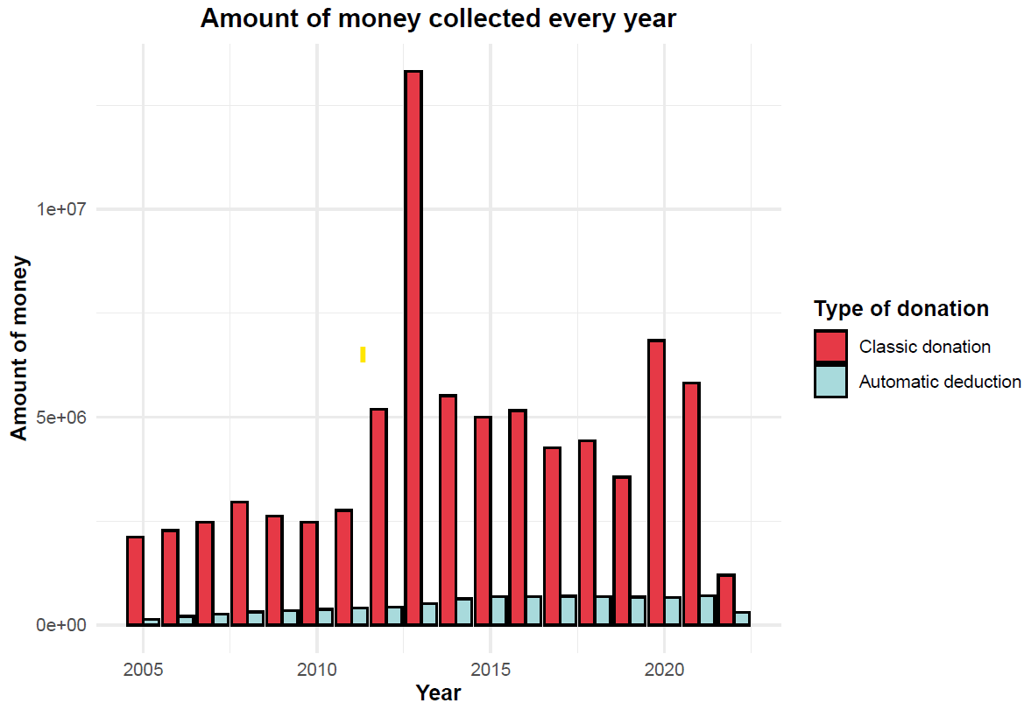
Collection by act type
The classic donations are on an uptrend with high variance
The automatic donations are on an uptrend with low variance
2013 stands as outliers with very high classic donations

Slide 6
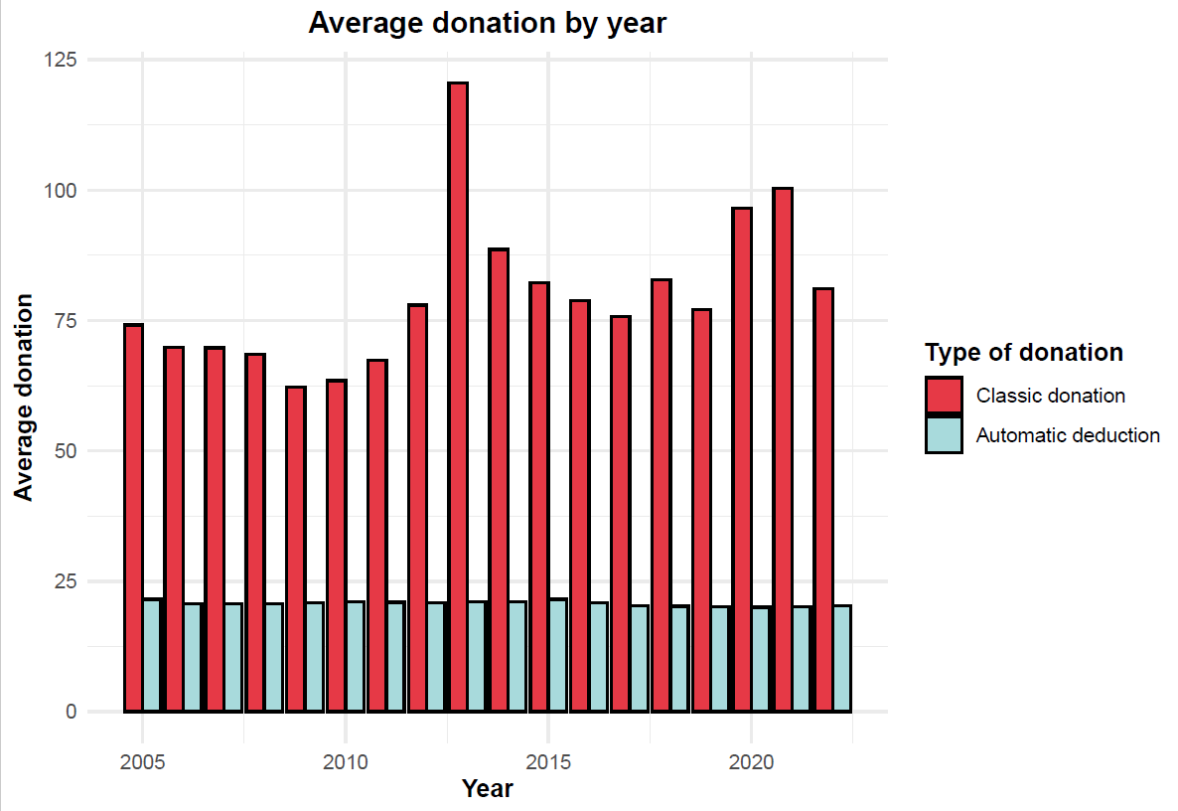
Collection by act type
The automatic deduction average remains constant through the years
Average classic donations have high fluctuations

Slide 7
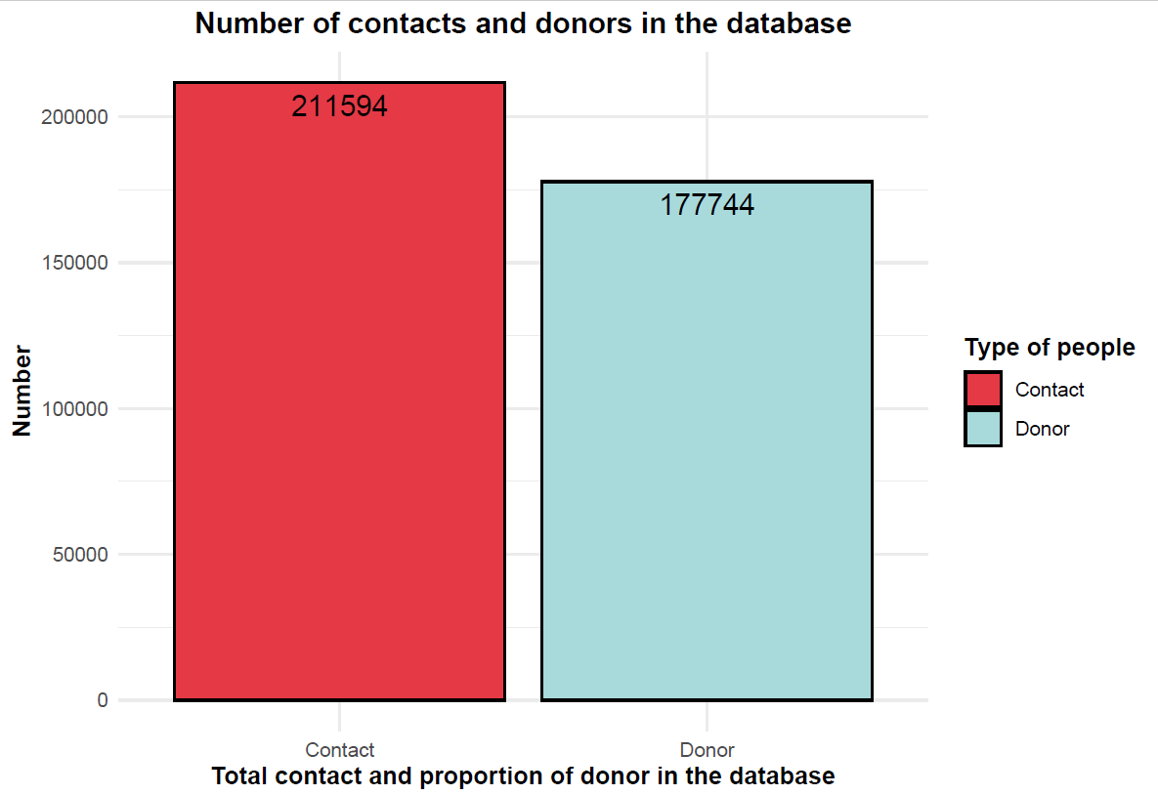
Contact Details
About 83% of all contacts maintained in the DB are donors
211,594 contacts are maintained in total

Slide 8
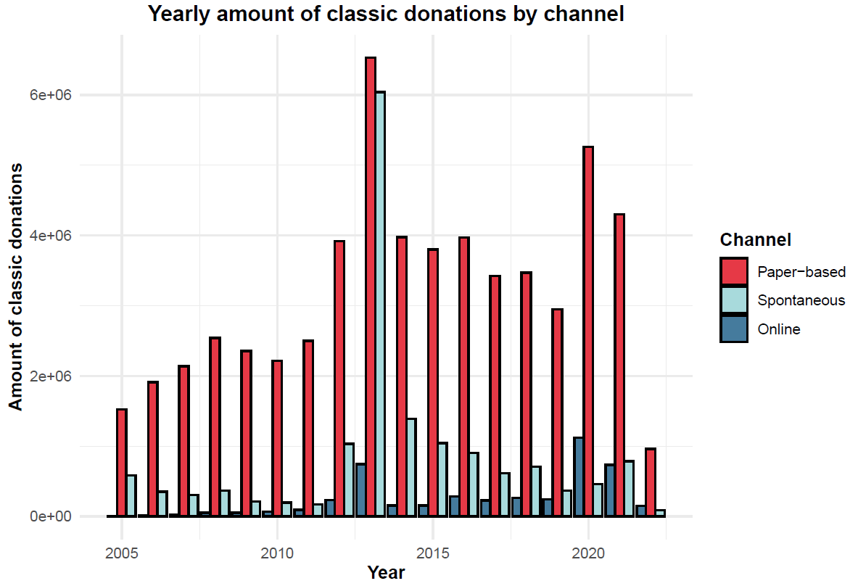
Channel Details: Classic Donations
Paper based channel draws the most donations
Online donations have been on an uptrend

Slide 9
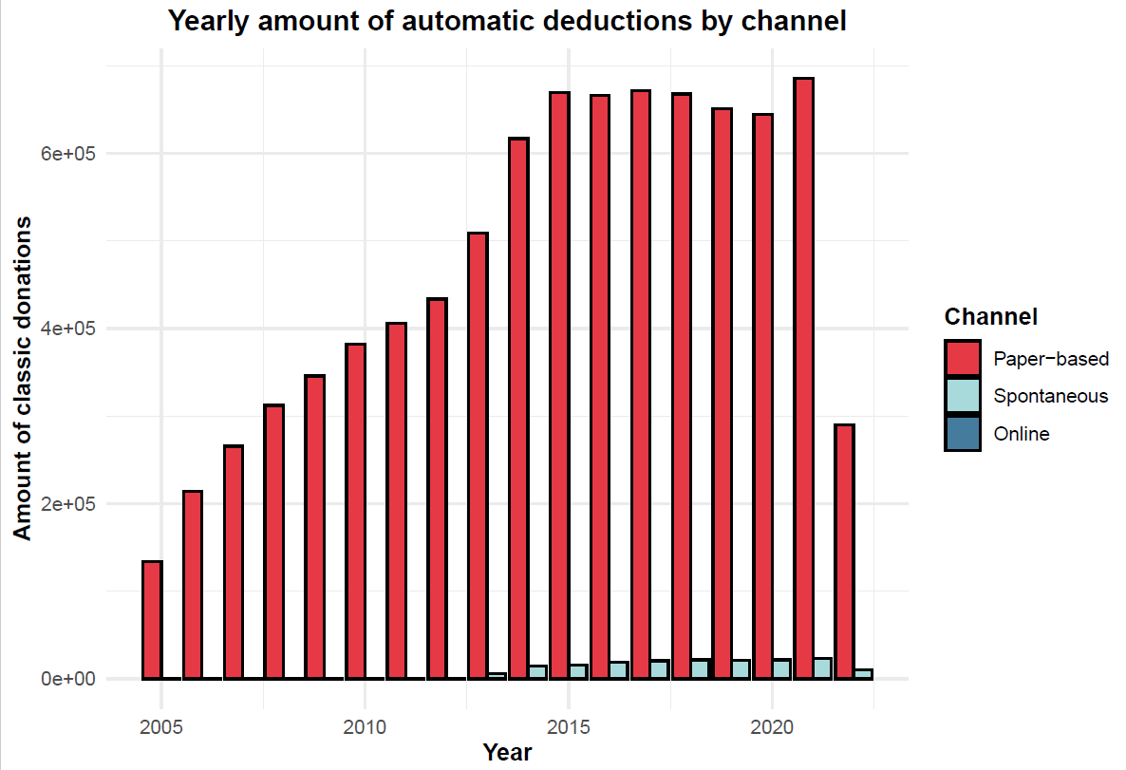
Channel Details: Automatic Deductions
TOP 5 campaigns of Classic Donations
Paper based channel primarily draw donations
Spontaneous channel has been on an uptrend

Slide 10
Campaigns
In the following section, we discuss the top campaigns so far and a few campaign details.

Slide 11
Top campaigns: Total Amount
TOP 5 campaigns of Classic Donations
TOP 5 campaigns of Automatic Deductions

Slide 12
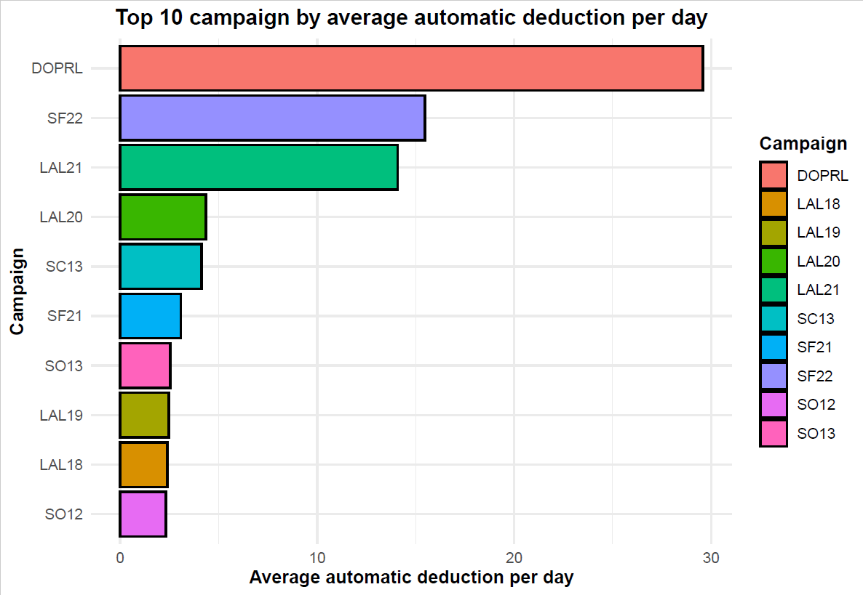
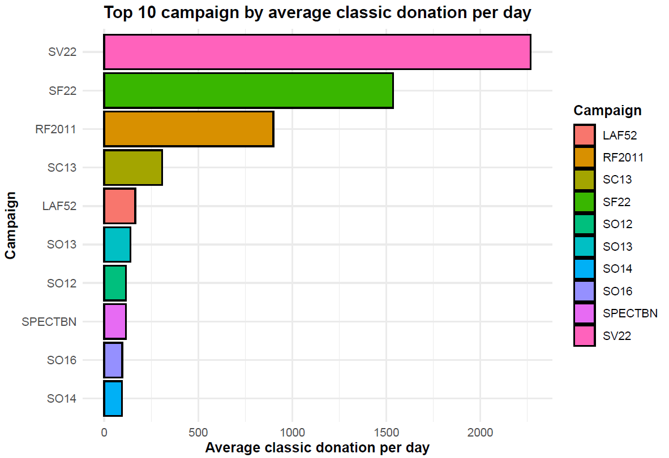
Top campaigns: Average Amount

Slide 13
Payment Methods
In the following section, we discuss the payment methods

Slide 14
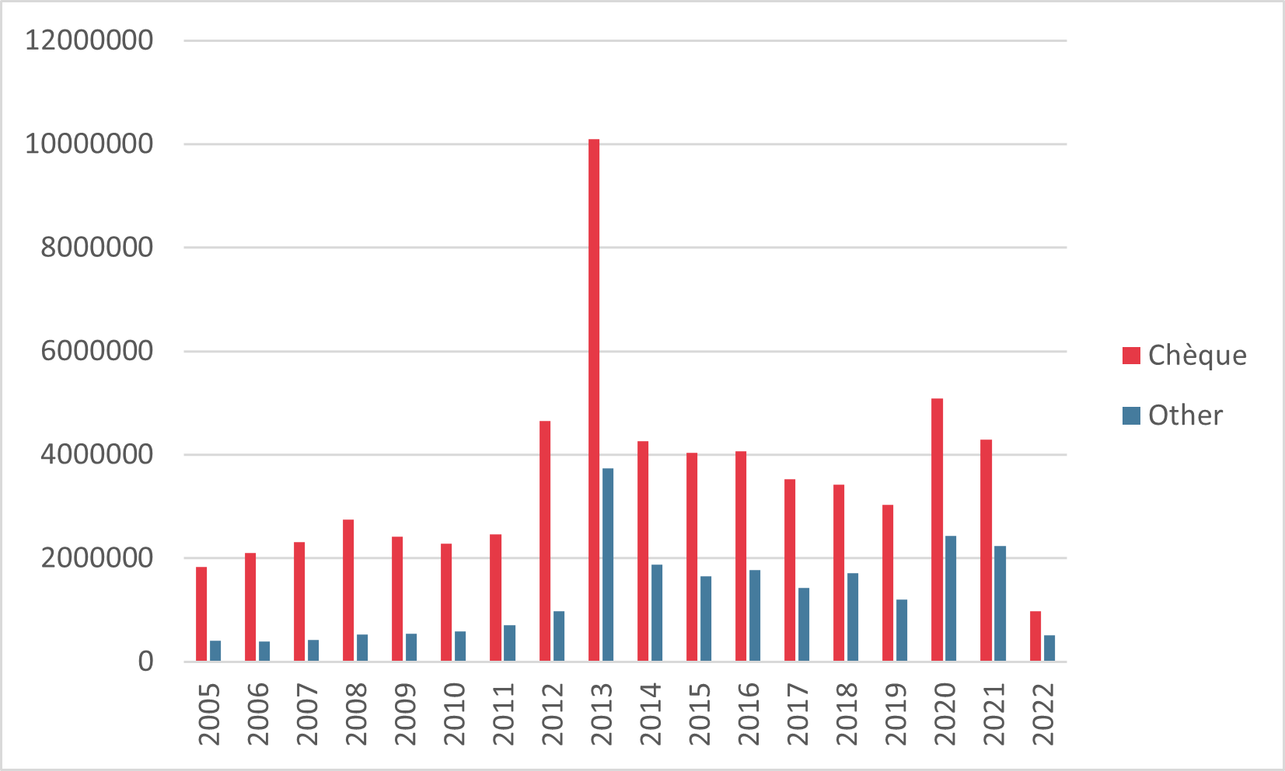
Payment methods
Cheques vs Others YOY
We see cheques outweigh all other methods is all years

Slide 15
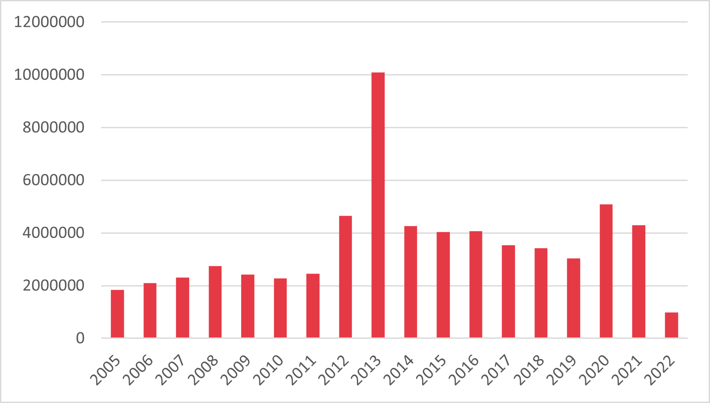
Payment methods: Cheque
A general uptrend is observed in collection
2013 stands as an anomaly year
Cheques collection YOY

Slide 16
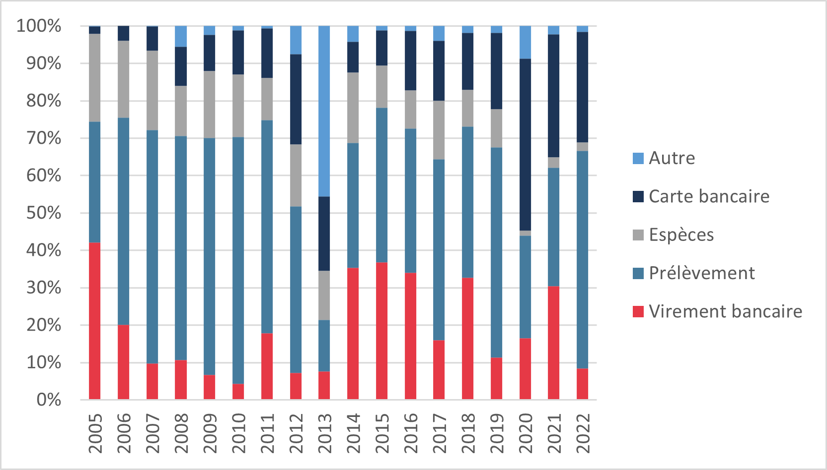
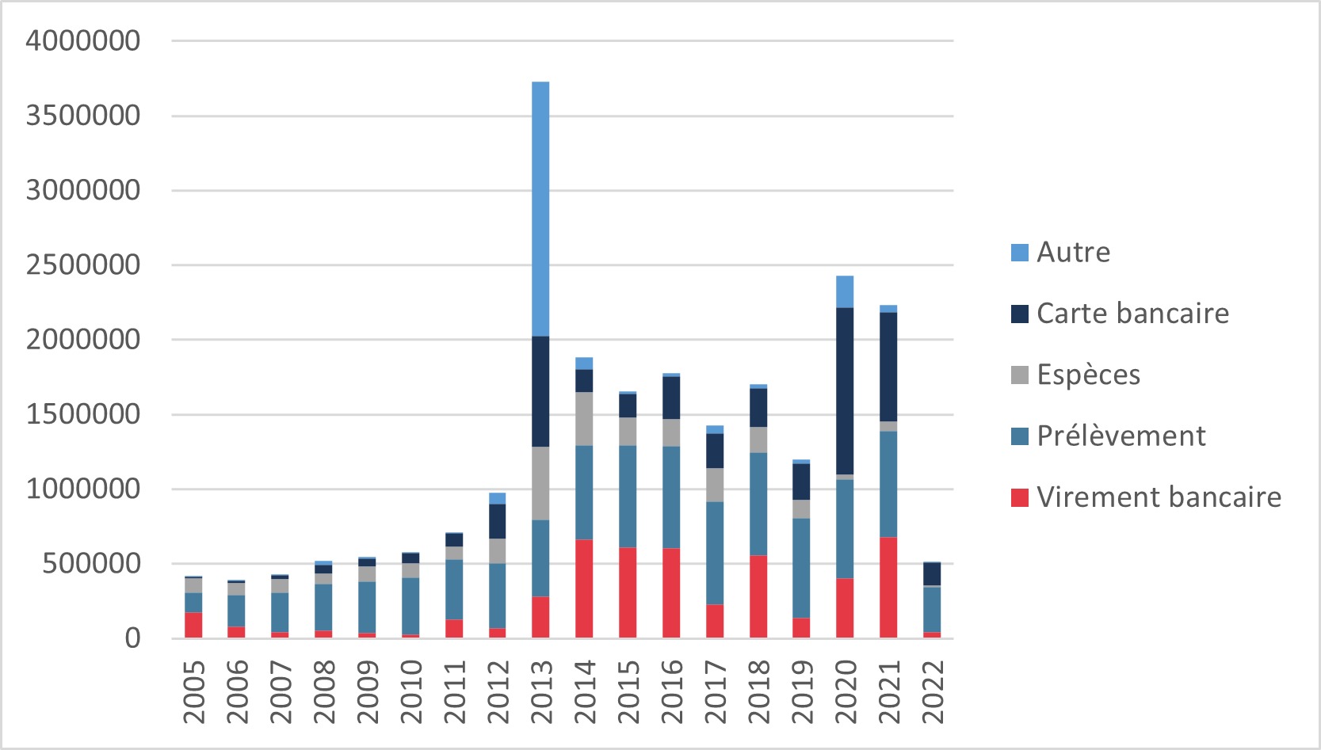
Payment methods: Other Methods
Other methods percentage YOY
Cash contributions have gone down through the years
Card contributions have increased over the years
2013 stands as an anomaly year
Other methods collection YOY

Slide 17



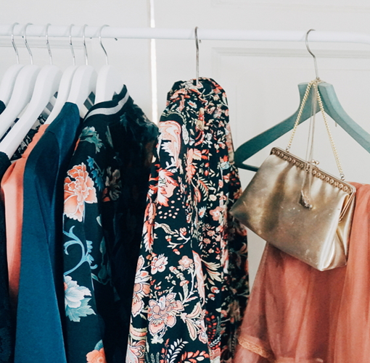
Agenda
Topic one
Topic two
Topic three
Topic four

Slide 18
Agenda
With PowerPoint, you can create presentations and share your work with others, wherever they are. Type the text you want here to get started. You can also add images, art, and videos on this template. Save to OneDrive and access your presentations from your computer, tablet, or phone.

Slide 19


Topic one
Subtitle

Slide 20
Chart

Slide 21
Table
 | Category 1 | Category 2 | Category 3 | Category 4
Item 1 | 4.5 | 2.3 | 1.7 | 5
Item 2 | 3.2 | 5.1 | 4.4 | 3
Item 3 | 2.1 | 1.7 | 2.5 | 2.8
Item 4 | 4.5 | 2.2 | 1.7 | 7

Slide 22
The way to get started is to quit talking and begin doing.
Walt Disney

Slide 23





Team
Name
Name
Name
Name
Name
Title
Title
Title
Title
Title

Slide 24
Timeline
Title
To start a presentation, go to the Slide Show tab, and select From Beginning.
Title
To display Presenter view, in Slide Show view, on the control bar at the bottom left select the three dots, and then Show Presenter View.
Title
During your presentation, the speaker notes are visible on your monitor, but aren't visible to the audience.
Title
The Notes pane is a box that appears below each slide. Tap it to add notes.
Title
If you don’t see the Notes pane or it is completely minimized, click Notes on the task bar across the bottom of the PowerPoint window.

Slide 25
Content
Subtitle
Subtitle
Add text, images, art, and videos.
Add transitions, animations, and motion.
Save to OneDrive, to get to your presentations from your computer, tablet, or phone.
Open the Design Ideas pane for instant slide makeovers.
When we have design ideas, we’ll show them to you right there.
Notes:
(These don’t have designer IDs since they were based off the default master slides already in the deck.

Slide 26
Content
Subtitle
Subtitle
Subtitle
Add text, images, art, and videos.
Add transitions, animations, and motion.
Save to OneDrive, to get to your presentations from your computer, tablet, or phone.
Open the Design Ideas pane for instant slide makeovers.
When we have design ideas, we’ll show them to you right there.
This PowerPoint theme uses its own unique set of colors, fonts, and effects to create the overall look and feel of these slides.
PowerPoint has tons of themes to give your presentation just the right personality.

Slide 27

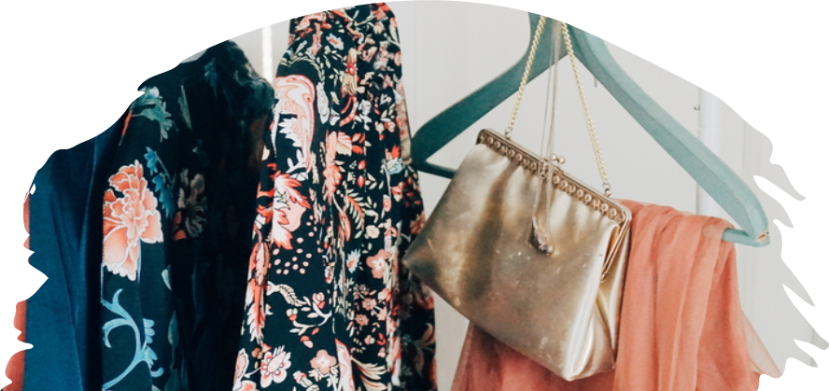
Summary
With PowerPoint, you can create presentations and share your work with others, wherever they are. Type the text you want here to get started. You can also add images, art, and videos on this template. Save to OneDrive and access your presentations from your computer, tablet, or phone.

Slide 28


Thank you
Presenter name
Email address
Website

